Slide 1

“Sentimental Analysis of Movie Review”
Batch members
KISHORE K S (1MJ16CS733)
MAX PINTO (1MJ16CS701)
ARINDAM BHATTACHARJEE (1MJ16CS709)
ANUJ SAINI ( 1MJ16CS711 )
Internal Guide
ASHWINI H K ASSISTANT PROFESSOR
Dept. of Computer Science & Engineering
MVJCE, Bangalore
Approved by AICTE |Affiliated to VTU | Recognized by UGC with 2(f) & 12(B) status |Accredited by NBA and NAAC

Slide 2
Content Outline
Introduction
Literature survey
Existing system and drawbacks
System architecture
Flowchart of how the system works
Implementation
Advantages & Disadvantages
Future scope
Conclusion
13. References
Approved by AICTE |Affiliated to VTU | Recognized by UGC with 2(f) & 12(B) status |Accredited by NBA and NAACk

Slide 3
Introduction
Sentiment analysis refers to the use of natural language processing, text analysis and computational linguistics to extract and identify subjective information in source materials. It aims to determine the attitude of a speaker or a writer with respect to some topic or the overall contextual polarity of a document. The attitude can be:
His or her judgement or evaluation
Affective state (That is to say, the emotional state of the author when writing)
The intended emotional communication (that is to say, the emotional affect the author wishes to have on the reader)
Approved by AICTE |Affiliated to VTU | Recognized by UGC with 2(f) & 12(B) status |Accredited by NBA and NAAC

Slide 4
Literature Survey-1
Title | Sentiment Analysis for Movie Reviews using NLP Authors: Prachi Shevate
Year | 2018
Methodology | Word2Vec
Technology | 1. Bag of words 2. Machine Learning 3. Python
Benefits | Ease of Use. It is a premade model by Google. Feature extraction is easy.
Issues | It is a predetermined model. The accuracy level using Word2Vec model is very low. We can say around 0.75. And the main focus of our program would be to get an accuracy that is higher thanWord2Vec model.
Approved by AICTE |Affiliated to VTU | Recognized by UGC with 2(f) & 12(B) status |Accredited by NBA and NAAC

Slide 5
Literature Survey-2
Title | Sentiment Analysis of Movie Review Using Supervised Machine Learning Techniques Author: Gurshobit Singh Brar
Year | 2018
Methodology | Path of Speech tagging
Technology | 1. Naïve Bayes 2. Machine Learning 3. Python
Benefits | Simple to understand. Simple implementation. We are using a JSON API to get the reviews.
Issues | We are using polarity, where preprocessing is inefficient. The use of polarity gives inefficient classification. Preprocessing is inefficient.
Approved by AICTE |Affiliated to VTU | Recognized by UGC with 2(f) & 12(B) status |Accredited by NBA and NAAC

Slide 6
Existing System and their drawbacks
Existing systems use ML algorithms like Naïve Baiyes and Random Forest tree.
Pre-processing is done by existing models such as Google’s Bag-Of-Words Word2Vec model.
Drawbacks
Not a modular approach.
Not suitable for large scale operations.
Pre-processing is not efficient.
Approved by AICTE |Affiliated to VTU | Recognized by UGC with 2(f) & 12(B) status |Accredited by NBA and NAAC

Slide 7
Problem statement
To perform sentimental analysis on professional movie reviews and classify them as positive of negative with high accuracy.
Approved by AICTE |Affiliated to VTU | Recognized by UGC with 2(f) & 12(B) status |Accredited by NBA and NAAC

Slide 8
Objective
To create a more flexible model so that it can be deployed in any way necessary.
Better and more efficient data pre-processing and cleaning.
Design and develop a model that can be easily ported to classify reviews in different languages.
Approved by AICTE |Affiliated to VTU | Recognized by UGC with 2(f) & 12(B) status |Accredited by NBA and NAAC

Slide 9
Proposed system and their advantages
The goal is to perform sentimental analysis on movie reviews.
Using methods such as Stopwords and Stemming for easy and efficient preprocessing of reviews.
Use of CountVectorizer to tokenize the reviews.
Using TF-IDF to generate inverse frequency of words to determine their importance.
Accuracy as high as 90% can be achieved with using CNN’s, this rate is significantly higher than that of current models.
Design and develop a model that can be easily ported to classify reviews in different languages.
Approved by AICTE |Affiliated to VTU | Recognized by UGC with 2(f) & 12(B) status |Accredited by NBA and NAAC

Slide 10
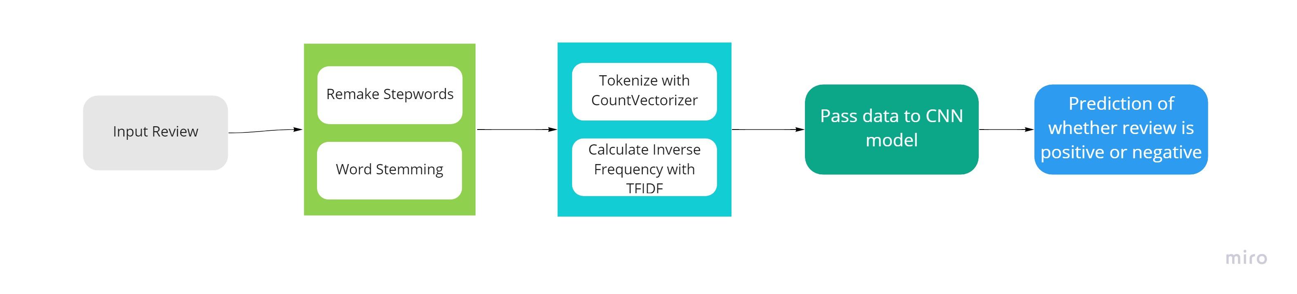
Proposed System Architecture
Data Cleaning
Feature Extraction
Approved by AICTE |Affiliated to VTU | Recognized by UGC with 2(f) & 12(B) status |Accredited by NBA and NAAC

Slide 11
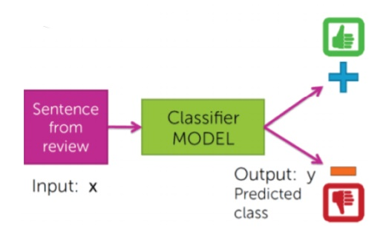
Sequence Diagram
Approved by AICTE |Affiliated to VTU | Recognized by UGC with 2(f) & 12(B) status |Accredited by NBA and NAAC

Slide 12
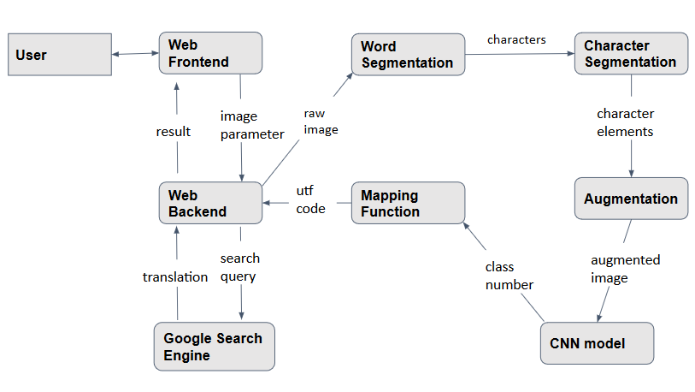
Data-flow Diagram
Approved by AICTE |Affiliated to VTU | Recognized by UGC with 2(f) & 12(B) status |Accredited by NBA and NAAC

Slide 13
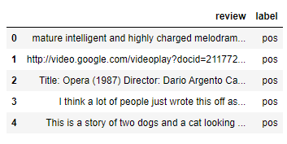
Data Set
The IMDB dataset is being used.
The dataset consists of 50,000 reviews.
It consists of 25,000 positive reviews and 25,000 negative reviews.
The data set is perfectly balanced.
Approved by AICTE |Affiliated to VTU | Recognized by UGC with 2(f) & 12(B) status |Accredited by NBA and NAAC

Slide 14
Cleaning
Remove all special characters that exist in the review.
Remove all garbage strings such as links HTML code that may be present in the corpus as a result of insufficient scrapping.
Approved by AICTE |Affiliated to VTU | Recognized by UGC with 2(f) & 12(B) status |Accredited by NBA and NAAC

Slide 15
Stopword removal and Stemming
Remove all stopwords from the corpus as they provide no meaning value to sentimental analysis.
Stemming the corpus to reduce words to their root. This process will remove any suffixes and affixes and reduce the word to its root and provide consistency.
Approved by AICTE |Affiliated to VTU | Recognized by UGC with 2(f) & 12(B) status |Accredited by NBA and NAAC

Slide 16
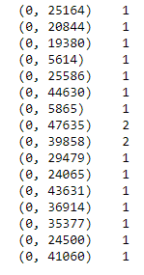
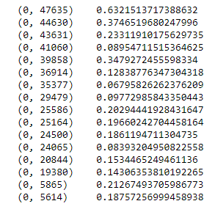
Tokenization and Inverse Frequency
Generating tokens for words in a corpus using CountVectorizer.
Use Tf-idf to generate inverse frequency values to determine the significance of the word in the corpus.
Approved by AICTE |Affiliated to VTU | Recognized by UGC with 2(f) & 12(B) status |Accredited by NBA and NAAC

Slide 17
The Neural Network
The application will be using a CNN network
It has an Input layer, one hidden layer and an output layer.
Input layer has 16 tensors and uses ReLU for activation.
Hidden layer has 16 tensors and uses ReLU for activation.
Output layer has 1 tensor and uses Sigmoid for activation.
Approved by AICTE |Affiliated to VTU | Recognized by UGC with 2(f) & 12(B) status |Accredited by NBA and NAAC

Slide 18
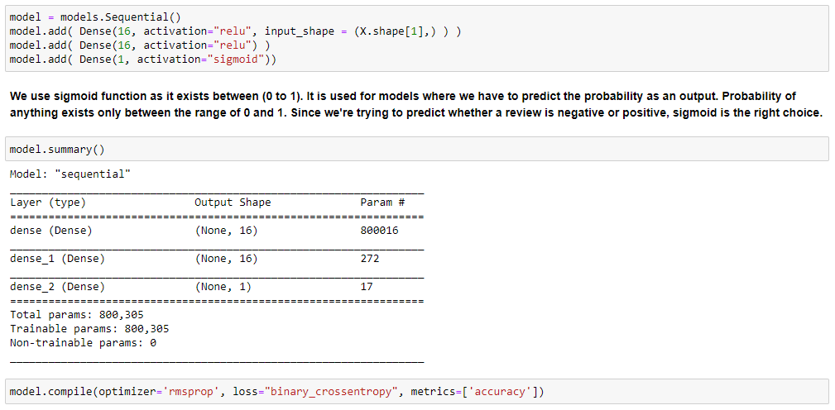

Slide 19
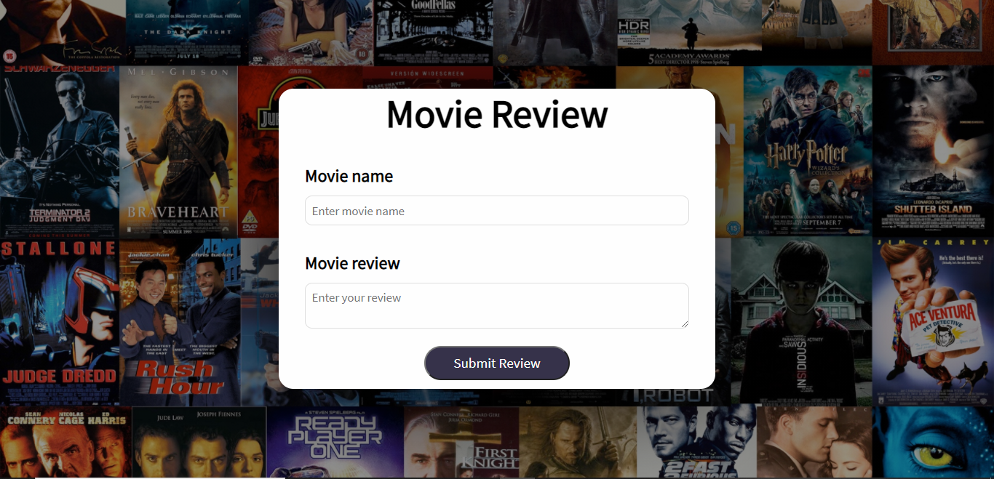
Output
A float value denoting the probability of the reviews being positive.
The classification of the review i.e., positive or negative
Approved by AICTE |Affiliated to VTU | Recognized by UGC with 2(f) & 12(B) status |Accredited by NBA and NAAC

Slide 20
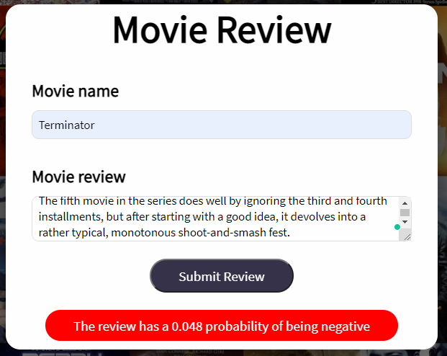
Output
Approved by AICTE |Affiliated to VTU | Recognized by UGC with 2(f) & 12(B) status |Accredited by NBA and NAAC

Slide 21
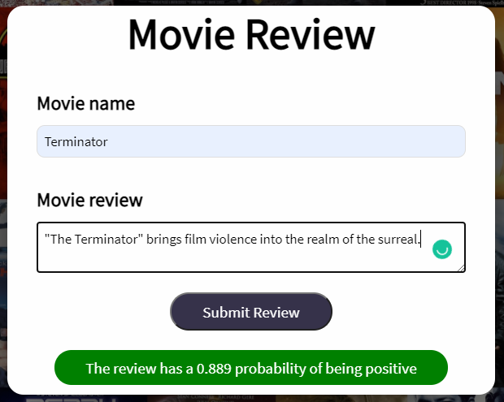
Output
Approved by AICTE |Affiliated to VTU | Recognized by UGC with 2(f) & 12(B) status |Accredited by NBA and NAAC

Slide 22
Expected Outcome
The application will take an review as input from the frontend.
It will then efficiently clean it and perform all necessary operations such as Stemming and StopWord removal.
It will then tokenize and generate inverse frequencies.
It will then classify the review as positive or negative with 90% accuracy.
Approved by AICTE |Affiliated to VTU | Recognized by UGC with 2(f) & 12(B) status |Accredited by NBA and NAAC

Slide 23
References
“The Sequential Model” https://keras.io/guides/sequential_model/
“How to Easily Deploy Machine Learning Models Using Flask” https://www.kdnuggets.com/2019/10/easily-deploy-machine-learning-models-using-flask.html
How to Encode Text Data for Machine Learning with scikit-learn https://machinelearningmastery.com/prepare-text-data-machine-learning-scikit-learn/
Approved by AICTE |Affiliated to VTU | Recognized by UGC with 2(f) & 12(B) status |Accredited by NBA and NAAC

Slide 24
THANK
YOU
Approved by AICTE |Affiliated to VTU | Recognized by UGC with 2(f) & 12(B) status |Accredited by NBA and NAAC

